Slide 1
Modelling Colombian Economy: Stock-Flow Consistent Prototype Growth Model
An adaptation from Yilmaz & Godin (2020).

Slide 2

Consumption Credit.
Households consumption is given by:
$$C_{H} = C_{H}^{d}+ {\dot{L}}_{H}^{D}$$
Households demand for domestic currency loans is:
$${\dot{L}}_{H}^{D}= θ_{0}+θ_{1}⋅{\left(C_{H}^{d}\right) }^{θ_{2}}$$
$$θ_{1}= 1−BUR$$
$$BUR= \frac{\left(rep + i_{H}^{L,D}\right)⋅ L_{H}^{D}}{\left(1−τ_{w}\right) ⋅ w ⋅ L}$$

Slide 3
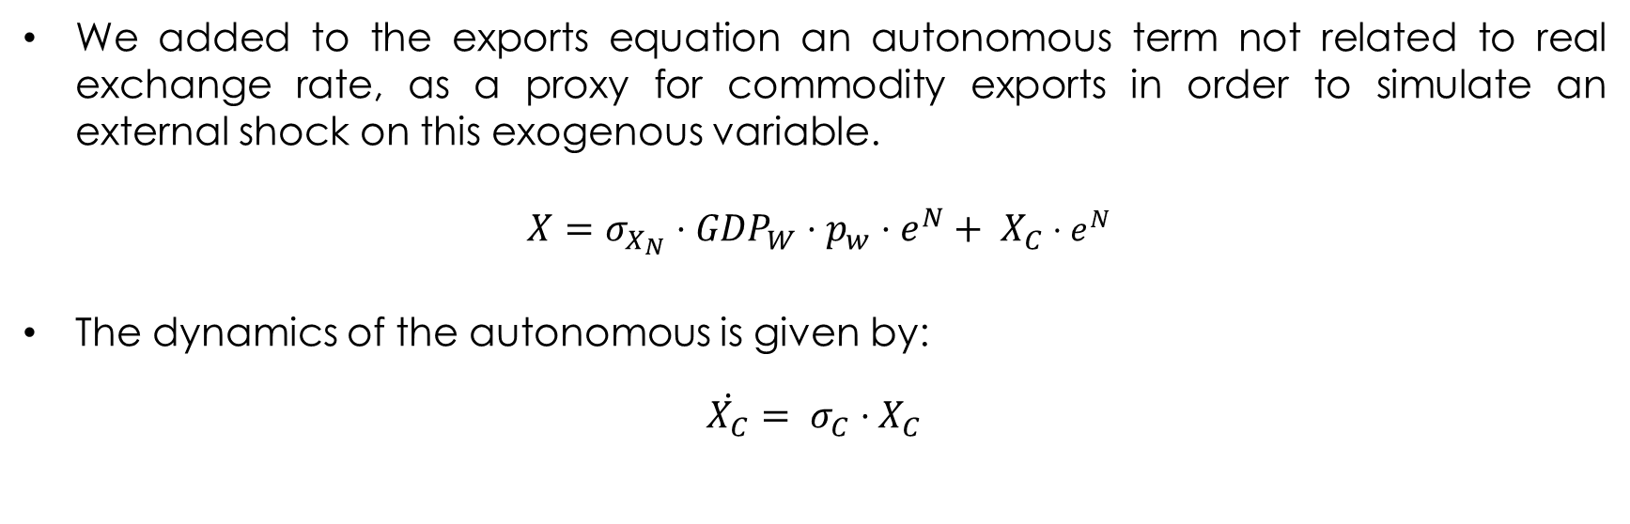
Exports.
We added to the exports equation an autonomous term not related to real exchange rate, as a proxy for commodity exports in order to simulate an external shock on this exogenous variable.
$X=σ_{X_{N}}⋅{GDP}_{W}⋅p_{w}⋅e^{N}+ X_{C}$ $⋅e^{N}$
The dynamics of the autonomous is given by:
$\dot{X_{C}}= σ_{C}⋅X_{C}$

Slide 4
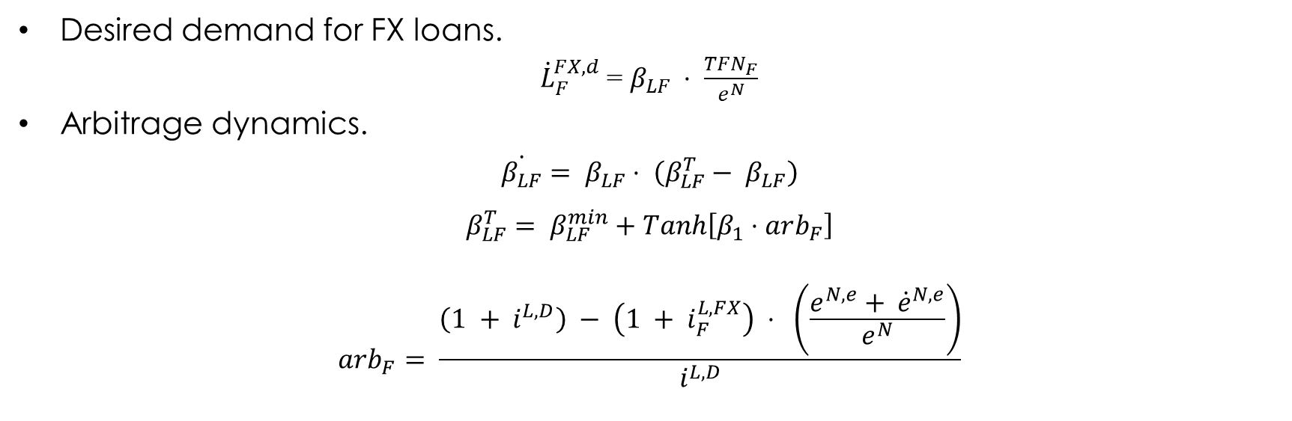
Firms FX loans – Demand.
Desired demand for FX loans.
${\dot{L}}_{F}^{FX,d}$ = $β_{LF} ⋅ \frac{TFN_{F}}{e^{N}}$
Arbitrage dynamics.
$$\dot{β_{LF}}= β_{LF}⋅ \left(β_{LF}^{T}− β_{LF}\right)$$
$$β_{LF}^{T}= β_{LF}^{min}+Tanh\left[β_{1}⋅arb_{F}\right]$$
$$arb_{F}= \frac{\left(1 + i^{L,D}\right) − \left(1 + i_{F}^{L,FX}\right) ⋅ \left(\frac{e^{N,e}+ {\dot{e}}^{N,e}}{e^{N}}\right)}{i^{L,D}}$$

Slide 5

Firms FX loans – Supply.
Credit rationing mechanism applied by the international banks:
${\dot{L}}_{B}^{FX,d}= {\dot{L}}_{F}^{FX,d}$
$${\dot{L}}_{B}^{FX}= {χ∙\dot{L}}_{B}^{FX,d}$$
$$χ= χ_{0}+χ_{1}∙NIIP+ χ_{2}∙\frac{\dot{GDP}}{GDP}$$
Interest rate on FX loans charged to the domestic banks
$i_{B}^{L,FX}= \left(1+θ\right)i^{W}$
$$θ= θ_{0}∙risk$$

Slide 6

Portfolio Flows – Option A.
Portfolio flows entering to the economy
$$WFF^{D}= ψ∙{\dot{B}}_{G}/e^{N}$$
$$ψ=ψ_{min}+ψ_{1}∙\left(r^{B,e}−r^{W, e}\right)$$
$$r_{G}^{B,e}= \frac{\left(1 +i_{G}^{B} \right)\left(1 − rsk\right)}{\left(\frac{e^{N,e} + {\dot{e}}^{N,e}}{e^{N}}\right)}$$
$$r^{W,e}=1+i_{G}^{W}$$
New Government bonds purchased by the rest of the world.
$${\dot{B}}_{G}^{W}=WFF^{D}∙e^{N}$$

Slide 7

Portfolio Flows – Option B.
Global portfolio flows.
$$WFF=Φ⋅GDP_{W}⋅p_{W}$$
Portfolio flows entering to the economy.
$$WFF^{D}=ψ_{WFF}⋅WFF$$
$$ψ_{WFF}=ψ_{min}+ψ_{1}∙\left(r^{B,e}−r^{W, e}\right)$$
$$r_{G}^{B,e}= \frac{\left(1 +i_{G}^{B} \right)\left(1 − rsk\right)}{\left(\frac{e^{N,e} + {\dot{e}}^{N,e}}{e^{N}}\right)}$$
$$r^{W,e}=1+i_{G}^{W}$$
New Government bonds purchased by the rest of the world.
$${\dot{B}}_{G}^{W}=WFF^{D}∙e^{N}$$

Slide 8
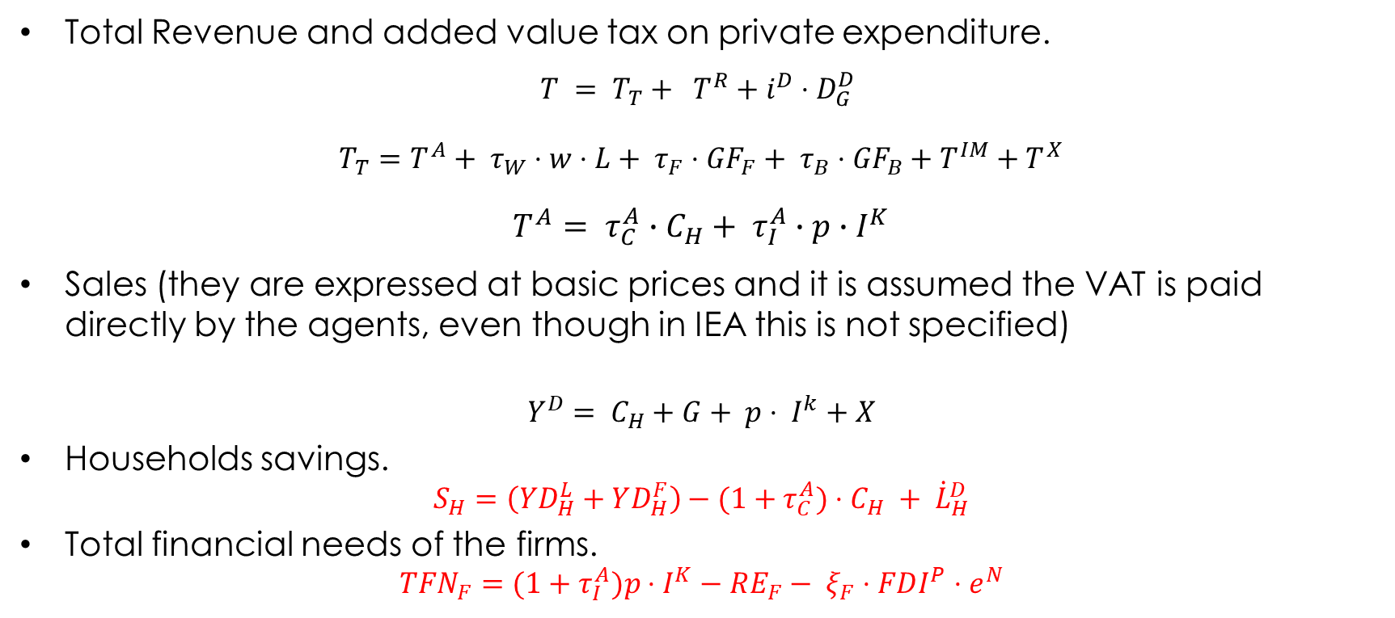
Government.
Total Revenue and added value tax on private expenditure.
$$T = T_{T}+ T^{R}+i^{D}⋅D_{G}^{D}$$
$T_{T}=T^{A}+ τ_{W}⋅w⋅L+ τ_{F}⋅{GF}_{F}+ τ_{B}⋅{GF}_{B}+T^{IM}+T^{X}$
$$T^{A}= τ_{C}^{A}∙C_{H}+ τ_{I}^{A}∙p∙I^{K}$$
Sales (they are expressed at basic prices and it is assumed the VAT is paid directly by the agents, even though in IEA this is not specified)
$$Y^{D}= C_{H}+G+ p⋅ I^{k}+X$$
Households savings.
$$S_{H}=\left(YD_{H}^{L}+YD_{H}^{F}\right)−(1+τ_{C}^{A})⋅C_{H} + {\dot{L}}_{H}^{D}$$
Total financial needs of the firms.
$$TFN_{F}=(1+τ_{I}^{A})p⋅I^{K}−RE_{F}− ξ_{F}⋅FDI^{P}⋅e^{N}$$

Slide 9
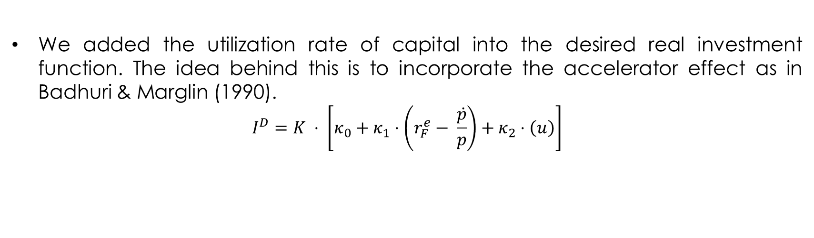
Investment.
We added the utilization rate of capital into the desired real investment function. The idea behind this is to incorporate the accelerator effect as in Badhuri & Marglin (1990).
$$I^{D}=K ⋅ \left[κ_{0}+κ_{1}⋅\left(r_{F}^{e}− \frac{\dot{p}}{p}\right)+κ_{2}⋅\left(u\right)\right]$$

Slide 10
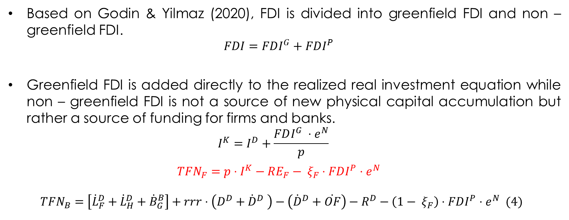
Foreign Direct Investment.
Based on Godin & Yilmaz (2020), FDI is divided into greenfield FDI and non – greenfield FDI.
$$FDI=FDI^{G}+FDI^{P}$$
Greenfield FDI is added directly to the realized real investment equation while non – greenfield FDI is not a source of new physical capital accumulation but rather a source of funding for firms and banks.
$$I^{K}=I^{D}+\frac{FDI^{G} ⋅e^{N}}{p}$$
$$TFN_{F}=p⋅I^{K}−RE_{F}− ξ_{F}⋅FDI^{P}⋅e^{N}$$
$$TFN_{B}=\left[{\dot{L}}_{F}^{D}+{\dot{L}}_{H}^{D}+{\dot{B}}_{G}^{B}\right]+rrr⋅\left(D^{D}+{\dot{D}}^{D} \right)−\left({\dot{D}}^{D}+\dot{OF}\right)−R^{D}−\left({1− ξ}_{F}\right)⋅FDI^{P}⋅e^{N} (4)$$

Slide 11
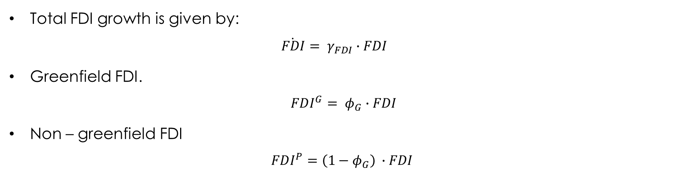
Foreign Direct Investment.
Total FDI growth is given by:
$$\dot{FDI}= γ_{FDI}∙FDI$$
Greenfield FDI.
$$FDI^{G}= φ_{G}∙FDI$$
Non – greenfield FDI
$$FDI^{P}=\left(1−φ_{G}\right) ∙FDI$$

Slide 12

Foreign Direct Investment.
Private equity accumulation by the rest of the world.
$${\dot{EQ}}_{w}= {\dot{EQ}}_{F}^{RoW}+ {\dot{EQ}}_{B}^{RoW}$$
Firm’s equities accumulation by the rest of the world.
$${\dot{EQ}}_{F}^{RoW}= ξ_{F}∙FDI^{P}∙e^{N}+FDI^{G}∙e^{N}$$
Bank’s equities accumulation by the rest of the world.
$${\dot{EQ}}_{B}^{RoW}=\left(1−ξ_{F}\right) ∙FDI^{P}∙e^{N}$$

Slide 13

Foreign Direct Investment.
Private equity accumulation by households.
$${\dot{EQ}}_{H}= {\dot{EQ}}_{F}^{H}+ {\dot{EQ}}_{B}^{H}$$
Firm’s equities accumulation by the households.
$${\dot{EQ}}_{F}^{H}=p∙I^{K}−TFN_{F}− {\dot{EQ}}_{F}^{RoW}=RE_{F}$$
Bank’s equities accumulation by the households.
${\dot{EQ}}_{B}^{H}= … =RE_{B}$

Slide 14

Foreign Direct Investment.
The dividends paid to the rest of the world are distributed considering the ownership structure of firms and banks
$$Div_{F}^{RoW}=\left(\frac{EQ_{F}^{RoW}}{EQ_{F}}\right)∙\left(Div_{F}\right)$$
$$Div_{B}^{RoW}=\left(\frac{EQ_{B}^{RoW}}{EQ_{B}}\right)∙\left(Div_{B}\right)$$

Slide 15
References.
Bhaduri, Amit & Marglin, Stephen, (1990). "Unemployment and the Real Wage: The Economic Basis for Contesting Political Ideologies," Cambridge Journal of Economics, Oxford University Press, vol. 14(4), pages 375-393, December.
Caiani, Alessandro & Godin, Antoine & Caverzasi, Eugenio & Gallegati, Mauro & Kinsella, Stephen & Stiglitz, Joseph E., (2016). "Agent based-stock flow consistent macroeconomics: Towards a benchmark model," Journal of Economic Dynamics and Control, Elsevier, vol. 69(C), pages 375-408.
Dafermos, Yannis, 2012. "Liquidity preference, uncertainty, and recession in a stock-flow consistent model," Journal of Post Keynesian Economics, Taylor & Francis Journals, vol. 34(4), pages 749-776.
Passarella, M. (2019). "From abstract to concrete: some tips for developing an empirical stockâ€“flow consistent model," European Journal of Economics and Economic Policies: Intervention, Edward Elgar Publishing, vol. 16(1), pages 55-93, April.
Pedrosa, I ; Biancarelli(2015).”Surges in capital inflows and the macroeconomic dynamics of peripheral economies- a stock-flow consistent model”.
Till van Treeck, (2007). "A Synthetic, Stock-Flow Consistent Macroeconomic Model of Financialisation," IMK Working Paper 06-2007, IMK at the Hans Boeckler Foundation, Macroeconomic Policy Institute.
Valdecantos, S. (2016).”Estructura productiva y vulnerabilidad externa- un modelo estructuralista stock-flujo consistente”

